Slide 1

Camera-Based Real Time Smart Phone Dictionary -Design Review # 2
Prepared by Team 22, Zhuoxin Chen, Hao Shi, Yaoyu Tao,Meng Wu, Hongyi Xin
Sponsored by Peisen Huang
2011/6/13

Slide 2

Outlines
Project Overview
Modifications
Customer Requirements
Engineering Specifications
Design Process
Top Level Design
UI Flow Chart
Image Processing
Database Design
Timeline

Slide 3
Project Overview
English to Chinese Dictionary
Camera Based Word-Recognition & Searching
IEEE/ACM/Wikipedia Extensions
Real Time Translation
Android Platform
Benchmark
Youdao Dictionary

Slide 4
Customer Requirements
New Reqs
Shall be able to add words to users’ dictionary
Shall be able to record latest search history
Modified Reqs
Need only English-Chinese translation, without multi-language extensions
Weight of reasonable results is raised

Slide 5
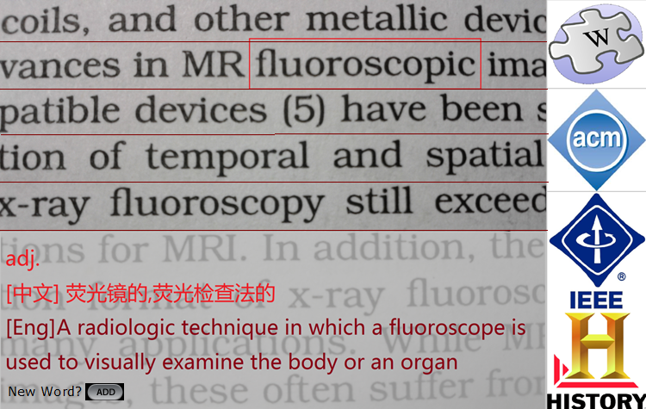
Revised Demo Interface

Slide 6
Engineering Specifications
Engineering Specifications
Operation Steps | Less than 100
Detection Size | 5mm x 15mm
Image Resolution | 16 x 16
Pixel Value Threshold | 1.00
Letter Distortion | 2x or better
Pattern Recognition Correctness | Greater than 80%
Tree Searching Levels | Less than 3 levels
Runtime Resource | Less than 1MB
Internet Extensions | IEEE, ACM, Wikipedia ,or more
History Collection | Latest 100 items or more

Slide 7
Control flow chart
UI
Freeze and capture the screen
Cut out selected word
DSP
Recognize the words
Database
Search for the word
Re-process the image if word is not found
Internet
Visit if existing internet connection
Invoked only if user needs
Preprocess the image

Slide 8
Top Level Design
Re-send if image not clear
User
Tap Screen
UI
Word Image
DSP
Key
word
Re-process if word not found
Internet
Tap
Button
Database
Add word

Slide 9
UI Flow Chart
Freeze Screen
Select Word
Fit into frame
Tap extension
Release Screen
Adjust the camera until the paragraph fit in to the frame.
Hold static button to freeze the screen.
Tap on the word to look up and wait the dictionary to respond.
Tap the extension button to look up on the Internet.
Release the static button to capture new paragraph.

Slide 10
Image Processing
Image Formats
Android supports BMP and JPEG
Intensive image (gray scale image)
Binary image (black and white image)
Image Segmentation
Divide image into regions such as lines, words and characters
Compute the projection profile of image
Locate the word based on the user input

Slide 11
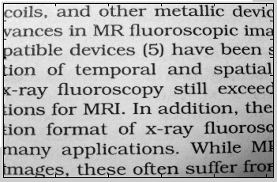
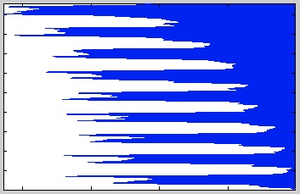
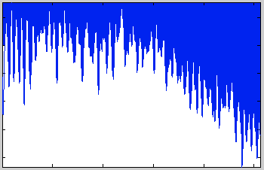
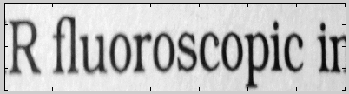
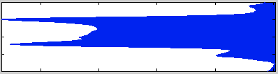
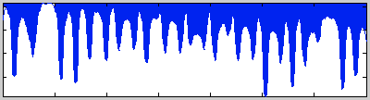
Image segmentation

Slide 12
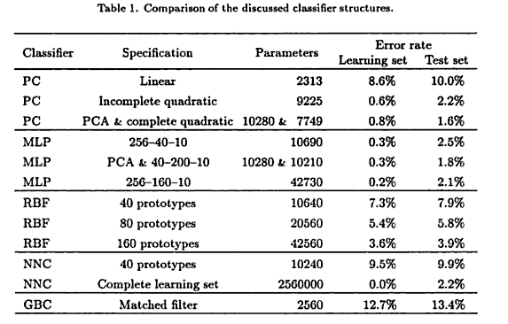
Character Recognition
Polynomial Classifier (PC)
Multilayer Perceptron (MLP)
Radical Basis Function (RBF)
Nearest Neighbor Classifier (NNC)
Handbook of character recognition and document image analysis,
by Horst Bunke,Patrick Shen-pei Wang

Slide 13
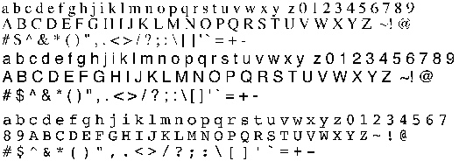
Character Recognition
Methods Selection
Accuracy and computational cost.
Principal Component Analysis has the best performance and relative less computation.
Learning Data
Multi-fonts
Adding rotation and distortion

Slide 14
Database Design
Overall Structure
Searching Strategy
Key Index of Main Table: First Letter
Intermediate Word Processing (IWP) inside the table
MID-based circular tree structure for history extension
Word Database
Main Table
MID
Extension
History Table
HID
Database Level
Table Level
Index Level
Word
Translation
MID

Slide 15
Database Flow Chart
DATABASE BLOCK
Word From UI
Word Processing
Move Cursor
Search
Result Return
Internet Extension
User-define Word
hit
!hit
Add to Main Table
ACK of Add
Return Result to UI

Slide 16
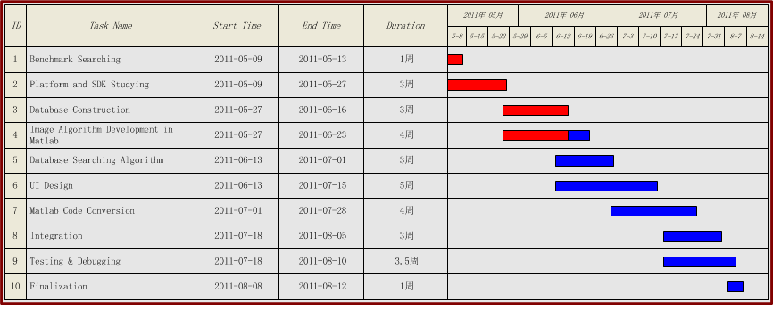
Timeline

Slide 17
Future Plan
Task | Duration | Main Member | Key Words
Image Processing | 6.13-6.26 | Meng Wu | Algorithm, MATLAB
Related APIs | 6.13-6.26 | Hao | Camera,TouchSensor,Web
Database Modify | 6.13-6.19 | Yaoyu | SQLite
UI Design | 6.20-7.10 | Hongyi
Code Convert | 7.11-7.24 | Yaoyu | MATLAB to JAVA
Internet Extension | 7.18-7.20 | Hao | Function extend & link
Integrate | 7.21-8.7 | All
Test | 7.18-8.7 | All | Debug,Testing & Modification

Slide 18

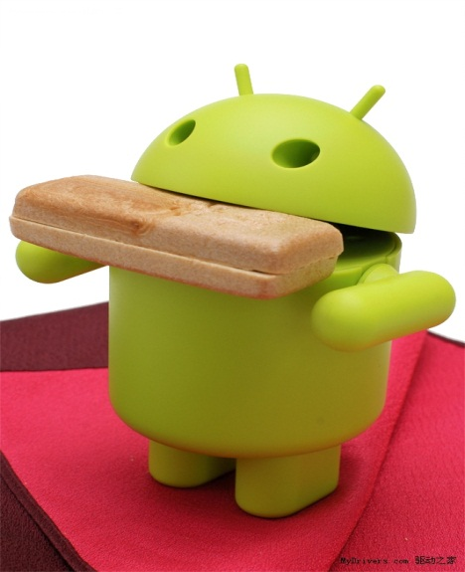
Q&A
Thank You
Thank You !

